Slide 1


Firm Profile

Slide 2


About Us
Ranked amongst the top #15 law firms in India and with about 25 years of rich experience, our journey has been marked by stellar growth and recognition over the past two decades.
Our Mission is to provide quality, professional, result-oriented legal and business solutions. Client commitment, innovation and teamwork are the cornerstones of our Legal Practice.
Our past awards, recognitions, ranking & listings are by:

Slide 3





WE ANSWER THE MOST DIFFICULT QUESTIONS
IN THE MOST EFFICIENT MANNER
Multi-speciality Firm
About 25 years of extensive experience
100+ Members
Firm with Attorneys across India
Pan India Outreach
Through 8 offices and partners offices across India
1000+ Global Clientele
Leading Fortune 500 MNC's, Indian Corporates, Banks, Financial Institutions, PSU's

Slide 4
Why H&S Partners?
  We closely work with our clients by understanding their business.
  We provide practical, relevant and tailored advice.
  We maintain high standard of ethics and professionalism.
  We deliver bespoke solutions with highest level of quality, confidentiality and integrity.
  We ensure client satisfaction by in-time solutions, exercising greater insights to understand the clients sectors.

Slide 5
Our Methodology
  Strategize a concrete action plan
  Statutory knowledge backed by 360-degree understanding of client's business needs
  Multidisciplinary team to bring in holistic approach
  Each transaction driven by Senior Partners
  Effective delivery and execution
  Transparency & coordination with client's team
  Post assignment assistance

Slide 6

Key Practice Areas
$85B+
$60B+
50+
$55B+
aggregate value of Dispute Management claims
aggregate value of corporate commercial M&A
Policy & Regulation mandates
aggregate value of Real Estate Project matters handled
Dispute Management Arbitration & Litigation
Corporate Commercial, M&A
Policy, Regulation & Strategy
Infrastructure Projects & Real Estate
Legal 500, Forbes India,
BWLegal World
Asian Law Profiles,
Benchmark Litigation
ACQ Global, Indian Legal Awards
Legal 500, Forbes India
Asian Law Profiles,
IFLR 1000,
Indian Legal Awards,
Indian Business Law Journal
Forbes India,
Asian Law Profiles,
Indian Business Law Journal
Legal Era, ACQ Global,
ICCA Awards
Legal 500,
Forbes India,
Insight Success,
INBA,
Legal Comprehensive, Corporate INTL

Slide 7
Niche Practice Areas
Corporate Governance, Risk advisory & Reputation Management
Restructuring & Insolvency
Legal Compliance & Due Diligence
IPR Management & Protective Action
Indirect Tax & GST
TMT & Data Privacy
Competition & Anti-Trust
Food Laws & Legal Metrology
Banking & Project Finance
Natural Resources, Energy & Environment
Labour Laws
Securities & Capital Markets

Slide 8
Dispute Management, Arbitration & Litigation
Litigation
  Constitutional matters
  Civil & corporate disputes
  Employee & Labour disputes
  Real estate litigation
  Recovery proceedings
  Telecom disputes
  Insolvency & bankruptcy disputes
  Cross-border litigation
Arbitration & Mediation
  Domestic & International Arbitration
  Project disputes
  Shareholder disputes
  Vendor distributor conflicts
  Environment law
  Anti-trust & Competition
End-to-end strategic support
  Preparing a pre-litigation strategy
  Strategic projections
  Dispute resolution strategy
  Recovery settlement strategy
  Litigation closure strategy
  Post litigation strategy
Forums
  Supreme Court of India, High Courts, District courts, National/State Consumer Dispute Forum, RERA, REAT, CAT, CIC, DRT, NGT, SAT, TRAI, CCI, TDSAT, NCLT, NCLAT, AERA, AERAAT, ITAT.
Know more >

Slide 9
Corporate Commercial, M&A
End-to-end Support
  Negotiation Assistance during the transaction from term sheet stage till closing of transaction.
  Structuring the Acquisition keeping in mind the requirement and objective of the Company.
  Advising clients on issues relating to Securities and Corporate law.
  Conducting Legal Due Diligence. Hand-holding in Documentation such as Term-sheet, Definitive Agreement, Shareholders Agreement, Shares Purchase, Agreement, Escrow Agreement, Stock – Swap Agreement, Employment Agreement and other related Agreements.
  The Firm undertakes the entire court procedure as envisaged in the Companies Act, 2013 for bringing in effect the acquisition.
  Policy and Regulatory assistance to develop, implement and sustain effective business strategies in India's complex regulatory environment.
  End- To End Solution from the Negotiation, Entity formation till Post Transaction Advisory
Know more >

Slide 10


Policy, Regulation & Strategy
Practice experience
  Preparing of white papers
  Theme discussions
  Support on emerging laws and regulations
  Public Policy Support
  Policy Predictability
  Policy Research
  Strategic Counselling
  Reputation Counselling
  Crisis & Risk Counseling
  Stakeholder Management
  Government Affairs
Over 40+ Policy & Regulation Mandates
"Best Law Firm in India for Policy, Regulation & Strategic Support"
For 8 years in a row
Know more >

Slide 11
Infrastructure Project & Real Estate
Extensive Experience of handling all aspects of entire property “life-cycle” such as Construction, Development diligence, Investment, Letting and Leasing, Real Estate Finance and Real Estate Litigation.
End-to-end Support
  Real Estate: We have the expertise to advise on integrated townships, hospitality, industrial and IT parks, SEZs, commercial complexes and also on foreign direct investment into real estate development projects in India.
  Projects: Advisory in all kinds of EPC contracts, construction contracts, development contracts and various kinds of consultancy contracts on behalf of construction companies, government organizations. we have developed a comprehensive knowledge base for complex tendering, concessions, contractual structure, project financing and PPP initiatives.
  Compliance and Litigation: unique expertise in providing legal assistance and advisory services in compliance with the terms of the Real Estate (Regulation and Development) Act, 2016
Know more >

Slide 12
Restructuring & Insolvency
Extensive Experience
  Contingency planning/ Pre-Insolvency/ Distress Advisory
  Negotiations with creditors for settlements and restructuring
  Negotiations / Arrangements with creditors and members
  Corporate Debt restructuring /Bi-lateral Debt restructuring with lenders; Out-of-court restructurings and refinancing
  Corporate Restructuring based on Mergers/ Demergers/ Hive off/Take over/Acquisitions
  Distressed debt trading; Insolvency filing requirements in BIFR / High Court etc.
  Formal insolvency proceedings before the court
  Debt Recovery Tribunal (DRT) including those under the Securitization and Reconstruction of Financial Assets and Enforcement of Security Interest Act, 2002 (SARFEASI)
  Enforcement of Security Interest; Portfolio Reviews; M&A in distress; Liquidations/Winding up.
  Facility, Security and Credit Support Reviews for Lenders and Borrower Groups.​
Know more >

Slide 13
Risk Advisory, Reputation Management & Defamation
End-to-end Support
  Business transformation and innovation, including artificial intelligence, collaboration, commercialization, intellectual property and data
  Crisis management
  Environmental, social and governance(ESG)
  Regulation and investigations
  Regulatory compliance consulting
  Sanctions and export controls
  Transactional risk-based due diligence and post-deal risk monitoring
  WTO and International Trade
Extensive Experience
  Risk Advisory
  Reputation Management
  Crisis Management
  Safeguard against Defamation
Know more >

Slide 14
Legal Compliance, Audit & Due Diligence
Over 1000+ successful Due Diligence completed.
End-to-end Support
  Identification of compliance with all the regulatory & statutory norms governing the industry and other Compliance Obligations under various legislations.
  We liaison with the Lead Managers and Implementers of the company for the timely execution of Compliance and submit the reports in this regard.
  We conduct Audits, verify compliance points, and assist in reaching a complete ‘right to operate level’ across various levels of operations.
  We build detailed and exhaustive Compliance tracker not only to map the activities but also to highlight the activities which are non-violated, less violated and violated.
  Our check-lists are prepared after comprehensive evaluation of the project and in-depth study of the industry in which organization operates.
  The duly filled compliance documents are verified by us at each stage.
Know more >

Slide 15
IPR Management & Protective Actions
End-to-end Support
  Advising clients on various strategies relating to intellectual property which involves identifying the IP of clients, conducting art search, devising strategies to protect and safeguard the clients and their IP.
  Drafting, filing and prosecuting registration applications, opposition applications etc in respect of copyrights, trademarks and patents.
  Drafting, filing and assisting clients in suits relating to infringement and passing off of their IP.
  Drafting, reviewing, vetting and negotiating a diverse range of intellectual property agreements like License Agreements, Assignment Agreements, User Agreements etc.
  Conducting due diligence with a specific focus on IP, involving a detailed review and documentation of IP in a company and providing assistance in evaluating the risks, liabilities and opportunities involved with IP.
  Providing legal opinions on various complex issues involved in IP.
Know more >

Slide 16
  Data Privacy Assessment and Audit and Protection Awareness, Training & Crisis management
  Policy and Notice Drafting
  Communications with Supervisory Authorities
  Data Subject Access Request handling
  Legal advisory and litigation assistance
  Value Added Services and related agreements;
  Agreements relating to procurement of telecom equipment and lease of satellite transponders
  Payment of license fee and reselling of telecom resources
  Dispute resolution, Arbitration and Litigation.
  Registrations, licenses and compliances under the relevant regulations
TMT & Data Privacy
End-to-end Support
  Registration of Service Providers with the appropriate Authorities. Advertising, Media & Broadcasting laws, rules and regulations
  User generated content and Website and service terms and conditions
  Information Technology related issues such as cyber-squatting, spamming
  Agreements including Distribution & Licensing, Master Services, Commissioning, Merchandising and Sponsorship, Music Composer etc.
  Strategic alliances and partnerships, acquisitions and related agreements
Know more >

Slide 17
Competition & Anti-trust
Diverse Experience from providing stand-alone competition law advice, assistance in filings and obtaining required approvals to represent clients before the Competition Commission of India and in courts.
End-to-end Support
  Competition litigation.
  Cartels and anti-trust investigations.
  Abuse of dominant position.
  Merger control regulations.
  Commercial agreements (such as distributor/ agency agreements, joint venture agreements, cooperation agreements, licensing agreements etc.).
  Competition law compliance strategies, programs and audits.
Know more >

Slide 18
Food Laws & Legal Metrology
End-to-end Support
  Compliance with the terms of the Food Safety and Standards Act.
  Licensing and documentation under the Food Safety laws.
  Implementation of detailed training systems to ensure compliance with food laws and regulations.
  Litigation management in various jurisdictions across the country.
  Implementation of Food Safety procedures in compliance with the applicable food laws and regulations.
  Formulation of education/training sessions on sampling processes and preparation of the guidance notes for the employees on Food Laws.
  Implementation of a thorough 360-degree certification process to ensure that all the food products are compliant with the labeling and packaging requirements.
  Government advocacy and policy matters to handle regulatory issues with respect to Food laws and Legal Metrology.
Know more >

Slide 19
Indirect Tax & GST
Extensive experience including structuring of transactions from indirect tax perspective, advising on tax compliances and implications on various business transactions
End-to-end Support
  GST Laws - CGST, SGST & IGST provisions
  (Erstwhile) Indirect Tax Laws - Excise / Service Tax/VAT
  Services under Custom Laws
  Compliance support for filing of GST returns
  GST Audit and reconciliation
  Litigation prevention & management strategy for GST & (erstwhile) indirect tax laws
  Assistance in representation before Tax Authorities/Tribunals/High Courts/SC
  Services for advance rulings and writs for various GST issues
  Opinions on complex issues/transactions under GST
  Study on Anti Profiteering, taxability & rate of tax for transactions
Know more >

Slide 20
Banking & Project Finance
Extensive Experience
  Project & Infrastructure Finance
  Acquisition & Asset Finance
  Debt restructuring,
  Acquisition finance,
  Real Estate Finance
  Corporate Debt
  Syndicated Loans
  Structured Debt Instruments
  Public Finance
End-to-end Support
  Due Diligence
  Financing Transactions
  RERA Compliance
  Litigation and Arbitration
  Strategy, Policy Oversight & Crisis Management
Know more >

Slide 21
Natural Resources, Energy & Environment
End-to-end Support
  Strategic Support and assistance in relation to Forest, Environmental and departmental clearances for Projects.
  Policy audits & advisory in Private sector
  Policy & Regulation support to stakeholders in the environment, forest and mineral policy space.
  Transaction support including negotiation, drafting and vetting agreements, due-diligence, legal opinions.
  Disputes, Writs & Arbitration in relation to regulatory pain-points and conflict amongst stakeholders in the mining and metal space.
  Policy and regulatory assistance to develop, implement and sustain effective business strategies in India’s complex regulatory environment.
  Representing Project Clearance and appearing in proceeding before various benches of National Green Tribunal(NGT)
Know more >

Slide 22
Labour Laws
End-to-end Support to our clients on employee disputes and disciplinary inquiries and investigations and sexual harassment related situations. We also specialise in contract labour and alternate employment arrangements, whistle blower complaints, employee grievance redressal, workforce restructuring, staff re-classification and mobility, workplace health and safety issues as well as immigration advisory.
Extensive Experience
  Employment Strategy and Documentation;
  Employee Benefits & Compensation Structuring;
  Employee Stock Options & Share Plans;
  Company Policies;
  Labour Law Advisory (including retrenchment and/or termination);
  Employment Agreement;
  HR Legal Audit;
  Employment Litigation;
  Non-Disclosure Agreements;
  Confidentiality Agreements;
  Non-compete Agreements and Downsizing​
Know more >

Slide 23
Securities & Capital Markets
Extensive Experience to all aspects of corporate finance and securities law and ensures that their compliance with SEBI regulations and guidelines. We advise clients on acquisition of shares, takeover of companies, public issue of shares (IPO) in India and abroad through ADRs and GDRs.
End-to-end Support
  Assistance in all forms of capital-raising and intricate domestic & cross-border financing.
  Devising strategies for acquisitions and reorganization restructurings
  Expert in all forms of structured financing and innovative funding solutions
  Assisted in fund formation and every type of structured bond transactions
  Hybrid project finance, project bonds, receivables financings and utility financings
  Full spectrum of debt capital including medium term notes, hybrid bonds, covered bonds, regulatory capital, project bonds, exchangeable and convertible bonds
  All aspects of restructurings, workouts and insolvency transactions​
  SEBI listing & delisting
Know more >

Slide 24

















































Clientele across sectors:
Conglomerates
Information Technology & TMT
Real Estate/Infra
Energy, Metal, Oil & Gas

Slide 25











































Clientele across sectors:
Retail and E-Commerce
OEMs
Automotive
Food, Dairy and Beverage
Health Care and Pharma

Slide 26






































Clientele across sectors:
Hospitality
Services
Logistics & Aviation
Media & Education
Chemical

Slide 27


Awards & Accolades
    Recognized in Asia M&A Rankings – 2024, 2023, 2022
    Firm recognized in the prestigious ALB India's List of “ Fast 30 Asia’s Fastest Growing Firms 2023.”
    Firm recognized in the prestigious ALB India's List of “India Firms to Watch 2023.”
    India's Super 50 Lawyers List - Dr. Manoj Kumar – 2023, 2022, 2021 & 2020
    India's Super 50 Lawyers in Asia and India List – Ms. Shweta Bharti – 2023 & 2020
    Managing Partners of the Year, Finalist (Dr. Manoj Kumar)- India Law Awards 2021
    ALB Women in Law Awards 2023 – Finalist in the Private Practitioner of the Year, India and Middle East – Ms. Shweta Bharti
    ALB India Rising Stars 2023 – Mr. Shantanu Malik
    Indian Law Firm of Year (finalist)- India Law Awards – 2022, 2021
    Recommended Firm for Regulatory Practice in India – 2021
    Notable firm for Regulatory Practice – 2020
    Asia M&A Rankings – 2023 & 2022
    Ranked as Top 20 Law Firms in India – Top Law Firm's Ranking 2018
    India's Top Dispute Lawyers – Mr. Shantanu Malik, 2021
    Ranked for Commercial, Corporate & M&A– 2025, 2024, 2023 & 2022
    Ranked for Dispute Resolution, Real Estate and Labour & Employment – 2025, 2024, 2023 & 2022
    Recommended Lawyer 2025 - Commercial Corporate and M&A (NCR), Dispute Resolution (NCR), Real Estate and Construction (NCR), Corporate and M&A, Real Estate and Construction – Ms. Shweta Bharti
    Recommended Lawyer 2025 - Commercial, Corporate and M&A(NCR), Corporate and M&A – Mr. Jyoti Kumar Chaudhary
    Recommended Lawyer 2025 – Real Estate and Construction (India & NCR) – Mr. Shantanu Malik
    Recommended Lawyer 2025 – Corporate and M&A – Mr. Amit Verma
    Leading Individual 2023 - Commercial, Corporate and M&A in Delhi NCR – Dr. Manoj Kumar
    Recommended Lawyer 2023 - Labour & Employment and Corporate and M&A – Dr. Manoj Kumar
    Recommended Lawyer 2023 - Labour & Employment and Corporate & M&A in India and Commercial, Corporate & M&A in Delhi NCR – Ms. Shweta Bharti
    Recommended Lawyer 2023 for Labour and Employment – Mr. Shantanu Malik
    Highly Regarded for M&A in India 2022 - Dr. Manoj Kumar Firms to Watch for Labour and Employment, 2022
    India’s Top 100 Law Firms
    RSGI’s Top Rated Law Firms for Social Responsibility 2025
    RSGI’s Top Rated Law Firms for Talent Development 2025

Slide 28



Awards & Accolades
    'Highly Regarded' for 'Banking' and 'Restructuring & Insolvency' - Ms. Shweta Bharti, 2024
    'Rising Star' in 'Restructuring & Insolvency' - Mr. Rohit Jolly, 2024, 2023
    Ranked for M&A in India – 2024, 2023, 2022 & 2020
    Ranked for Restructuring and insolvency – 2024, 2023, 2022 & 2021
    Ranked for Banking – 2024, 2023
    Ranked for Project Development: Energy & Infrastructure – 2024, 2023
    Notable Practitioner for Banking, Restructuring and Insolvency, Ms. Shweta Bharti - 2023
    Rising Star Partner for Restructuring and Insolvency, Mr. Rohit Jolly – 2023
    Recognised for Commercial & Corporate - 2024
    Recognised for Policy & Regulation at Indian Law Firm Awards – 2024, 2023
    'India’s Top A-List Lawyer' - Ms. Shweta Bharti - 2023
    Best Policy & Regulatory Practice – 2022, 2021, 2020, 2019, 2018, 2017, 2016, 2015, 2014, 2013 (ten years in a row)
    Recognised for Aviation Practice in India – 2022 & 2021.
    India’s Top A-List Lawyer 2022-2023: Ms. Shweta Bharti
    India Law Firm Awards 2023 – Policy & Regulation and Corporate & Commercial
    Future Legal Leaders – Mr. Shantanu Malik, 2023, 2022, 2021
    50 up-and-coming Future Legal Leaders- Mr. Shantanu Malik 2022
    Ranked as Litigation Star, Commercial & Transaction – Ms. Shweta Bharti – 2025, 2024
    Ranked as Litigation Star, Commercial & Transaction – Mr. Jyoti Kumar Chaudhary – 2025
    Ranked for Commercial & Transactions in India – 2025, 2024, 2023, 2022 & 2021
    Ranked for Labour & Employment – 2025, 2024, 2023, 2022 & 2021
    Ranked for Construction in India – 2025, 2024, 2023, 2022 & 2021
    Ranked for Insolvency in India – 2025, 2023, 2022 & 2021
    Ranked Notable firm for Government & Regulatory Practice – 2025, 2024, 2023 & 2022
    Ranked for Dispute Resolution in Asia-Pacific, 2021.
    Recognized as one of Asia-Pacific's Top 100 Women in Litigation – Ms. Shweta Bharti- 2021 & 2020
    Conferred as Dispute Resolution Star by Benchmark Litigation 2020.- Ms. Shweta Bharti

Slide 29



Awards & Accolades
    Recognised for Corporate M&A in India – 2024, 2023, 2022 & 2021
    Recommended Firm for Regulatory in India – 2024, 2023, 2022 & 2021
    Recognised for Dispute Resolution in India – 2024, 2023, 2022 & 2021
    Recognised for Restructuring & Insolvency in India – 2024, 2023, 2022 & 2021
    Ranked Firm for Aviation – 2024, 2023 & 2021
    Ranked Firm for Labour & Employment, Banking & Finance, Construction and Real Estate – 2024, 2023
    Asialaw Leading Lawyers 2023 - Ms. Shweta Bharti
    Top 50 Law Firms (Above 10 years of experience) – Legal Powerlist 2023
    Top Managing Partners in India (Dr. Manoj Kumar) -2022, 2021 & 2020
    Top Individual Lawyer (above 10-year experience) – Ms. Shweta Bharti – 2022, 2020
    Recognised as Top Law Firm(above 10 Year experience)
    Top 100 Lawyers in India for Privatization & Divestments (Dr. Manoj Kumar)
    Top 50 Law Firms for Corporate & Commercial - Legal PowerList 2021
    Top 50 Law Firms for Alternate Dispute Resolution and Arbitration & Mediation Legal PowerList- 2021.
    Top 50 Law Firms for Arbitration in India - Legal PowerList 2020.
    Top 50 Law Firms for Aviation in India- Legal PowerList 2020.
    Recognized among Top 50 Law Firms for Restructuring, Insolvency & Bankruptcy and Real Estate & Construction- Legal PowerList 2021
    Top 50 Law Firms for Energy (Renewable & Conventional), Insolvency & Bankruptcy, Real Estate & Construction and Arbitration in India, 2020
    Top Individual Lawyers in India- Dr. Manoj Kumar - Legal PowerList 2020- 2021.
    Women Lawyer of the Year by BW LegalWorld (Ms. Shweta Bharti) -2024
    Policy Law Firm of the Year at Global Legal Awards by BW LegalWorld – 2019
    Managing Partners of the Year (Dr. Manoj Kumar) at Global Legal Leaders Awards 2021 by BW Legal World & BW BusinessWorld – 2021
    Managing Partner of the year by BW Legalworld- 2020: Dr. Manoj Kumar

Slide 30



Awards & Accolades
    Best Law Firm for Public Policy & Regulatory by Legal Era Awards, 2019
    Best Public Policy & Regulatory Lawyer (Dr. Manoj Kumar) by Legal Era Awards, 2018
    Distinguished Legal Minds- Dr. Manoj Kumar, 2020
    Distinguished Legal Minds- Ms. Shweta Bharti, 2020.
    Awarded as the “Women in Law” by Legal Era 2019 – Ms. Shweta Bharti
    Awarded as one of the “Leading Lawyers” for Dispute Resolution Arbitration & Litigation practice area by Legal Era Rankings 2023 – Ms. Shweta Bharti
    Recommended Firm for Regulatory Practice in India - 2021
    Notable firm for Regulatory Practice – 2020
    Best Legal Advisory Services of the Year Award – 2023
    Best Law Firm for Public Policy & Regulatory by ICCA Excellence Awards - 2019

Slide 31
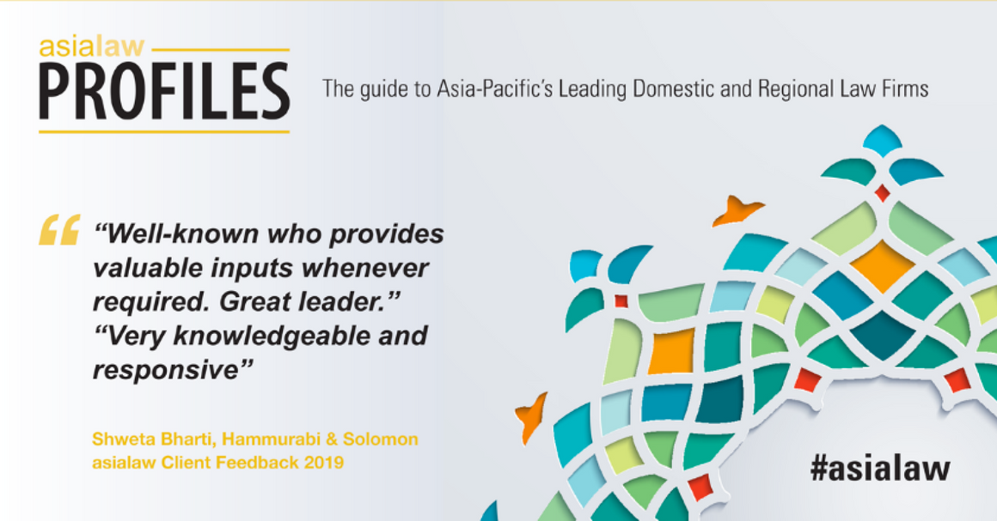


Client Testimonials
"The expertise & knowledge of the H&S team are its great assets. The effective & pragmatic solutions offered by the firm have helped us in achieving commercial success."
"The Firm can be counted amongst the best advisors for merger and acquisition in the country. We have a long standing relationship with the firm and we will be looking forward to working together in future projects and assignments."

Slide 32




"The Firm has been providing legal and end‐to‐end support for our business objectives and have been successful representing our interests in issues pertaining to general corporate advisors, and transactional documents on wide range of projects."
"The team's tremendous efforts external and internal have help us a great deal in achieving the desired outcome in areas of public policy and regulation. The team… inspire(s) confidence with their application of knowledge combined with effective communication. "
“...H&S Partners has an institutionalized thought process that brings a finer outcome at the sweet spot of strategy, public policy and regulation.”
"We appreciate the quality, attentiveness and responsiveness of the Lawyers at Hammurabi & Solomon. The Firm can be counted amongst the best in the Technology, Media & Telecom, Agri‐Business, Compliance, Nutrition & Health, Labour, Merger & Acquisition, and Tax in the country."

Slide 33

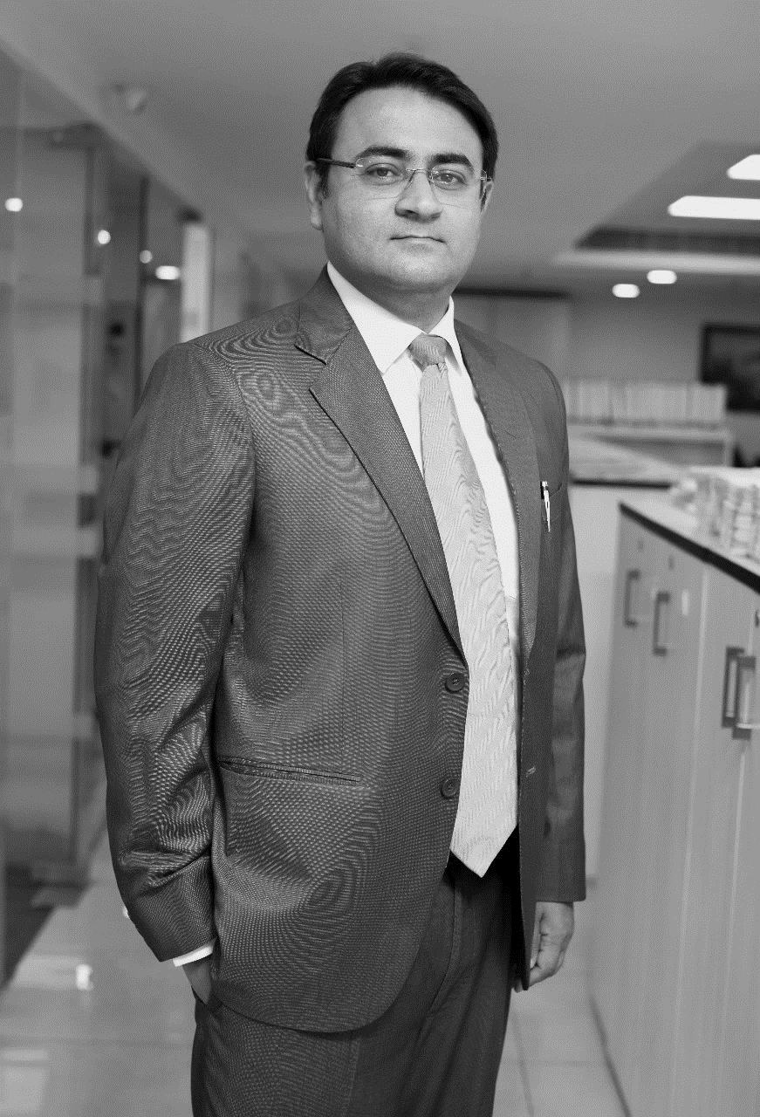

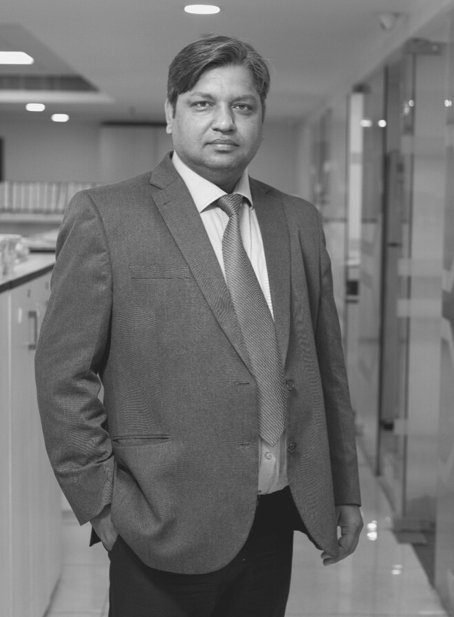
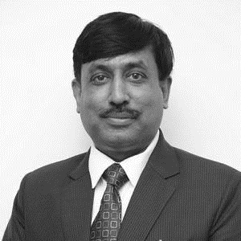

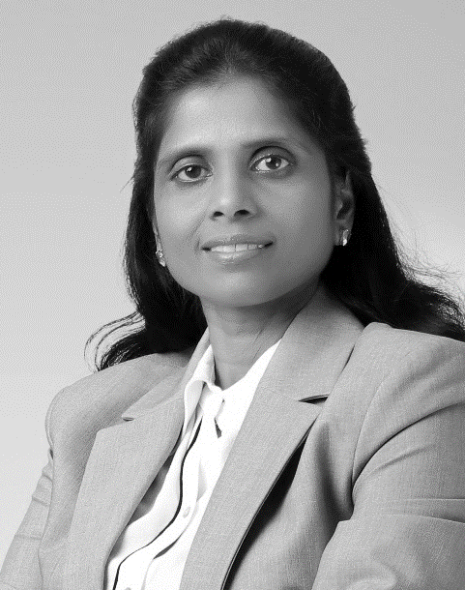


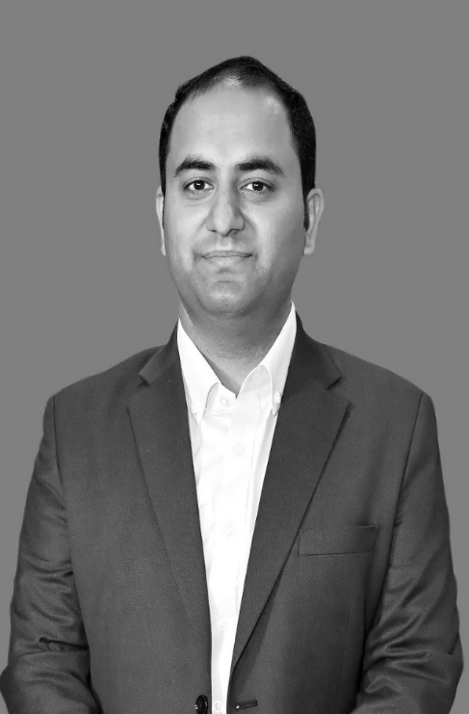


Our Team
19
Leaders
100+
Member team across India
200+
Years of Cumulative Experience

Slide 34

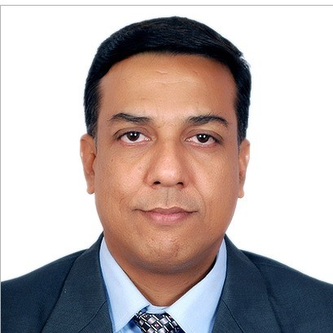
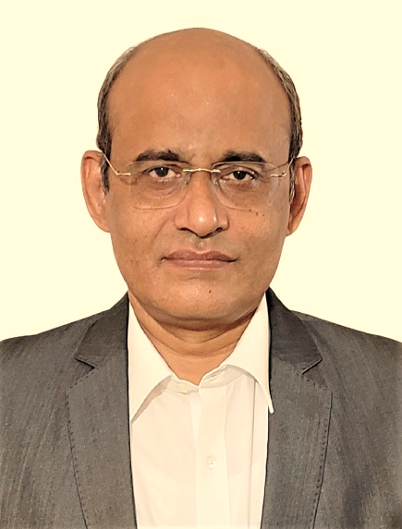
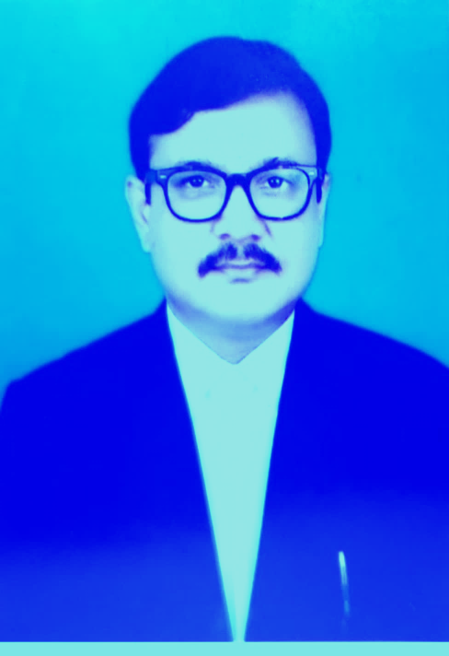

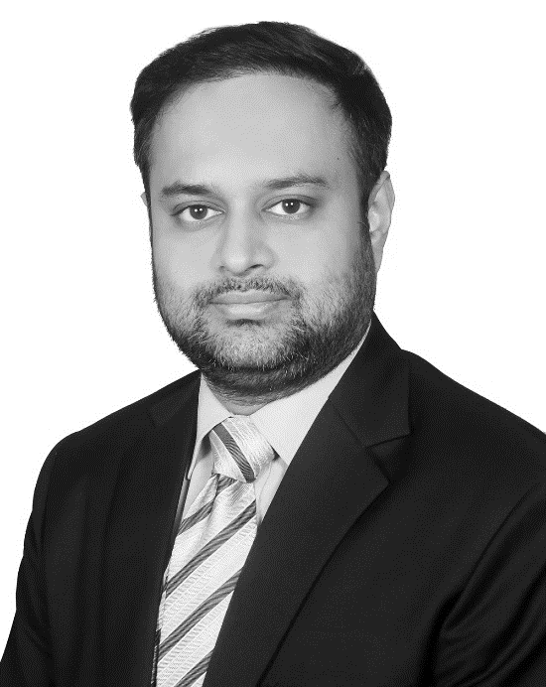

Our Team
19
Leaders
100+
Member team across India
200+
Years of Cumulative Experience

Slide 35

Consulting with Lawmakers for over two decades
    Public Policy Support
    Policy Predictability
    Policy Research
    Strategic Counselling
    Reputation Counselling
    Crisis & Risk Counseling
    Stakeholder Management
    Government Affairs
Strategic Business Planning, Regulatory & Public Policy, Government Affairs, and Marketing Services
India Strategy Group has not only worked with and represented multiple Fortune 50/500 MNC’s and Brands across Sectors but also with a spectrum of Government departments and Enterprises at both National as well as State levels.
​
ISG has successfully assisted the Government of India, State Governments, and Public Sector Institutes & organizations on a multitude of issues to enable deeper public-private participation in integration and developments.
www.indiastrategygroup.com/

Slide 36



Delivering Bespoke Compliance Solutions since 2017
GRC software packed with custom data to manage compliance & streamline risk across the organization
    Legislative Compliance Support
    Contract Management
    Legal Due Diligence
    Ethics & Policy Compliance
    Pre-emptive Legal Updates
    Governance Assurance
We run Compliance Projects across 70+ Locations Globally
https://www.lexxo.in

Slide 37
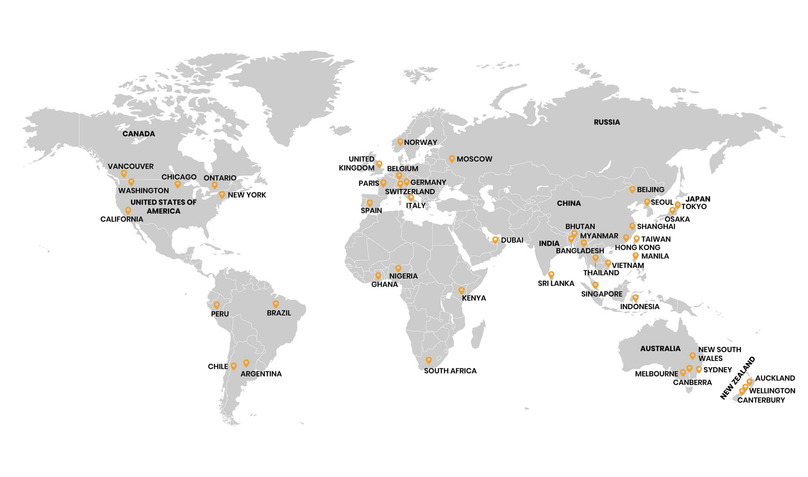


Global Outreach
International Affiliations
India Member - Alliance of International Business Lawyers
https://www.alliuris.org
ILAN (International Legal Advocacy Network)

Slide 38

Reach out to us:
Head Office:
405 & 405A, Rectangle One - 4th Floor
Saket District Centre, Saket
New Delhi - 110017
Other Offices:
Mumbai | Bengaluru | Chennai | Hyderabad | Patna | Ahmedabad | Ranchi
Website: https://www.hammurabisolomon.in/
Email: mailadm@hammurabisolomon.com
Phone: (+91-11) 4155 1825

